Slide 1
Evaluating Physical-Layer BLE Location Tracking Attacks on Mobile Devices
CSE891 | Research Paper Presentation
CSE891|Research Paper Presentation
Written by:
Hadi Givehchian , UC San Diego
Nishant Bhaskar, UC San Diego
Eliana Rodriguez Herrera, UC San Diego
Héctor Rodrigo López Sot, UC San Diego
Christian Dameff , UC San Diego
Dinesh Bharadia, UC San Diego
Aaron Schulman, UC San Diego
Presenting by:
Varuntej Kodandapuram

Slide 2
Content
CSE891 | Evaluating Physical-Layer BLE Location Tracking Attacks on Mobile Devices
Introduction
Background
Challenges
Design Details
Algorithm Details
System Implementation
Results

Slide 3
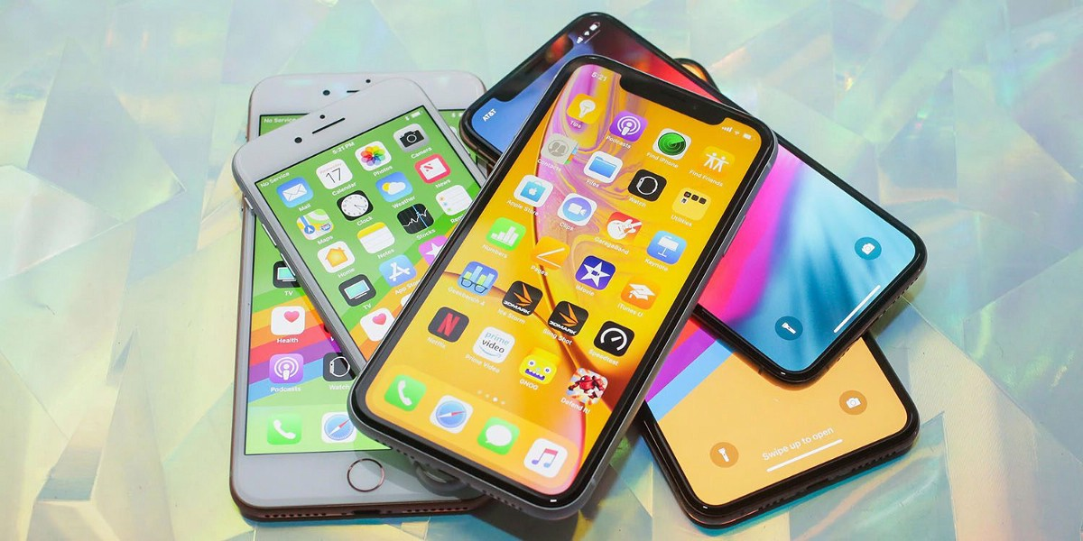
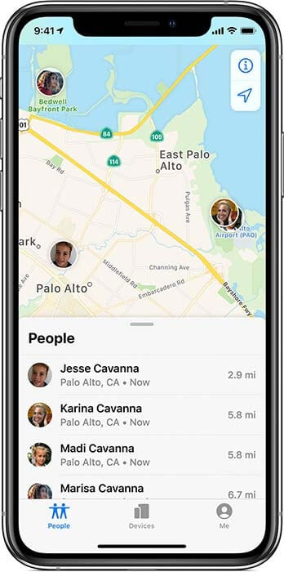
Introduction
CSE891 | Evaluating Physical-Layer BLE Location Tracking Attacks on Mobile Devices
In today’s world everything is linked to a smart phone without it the technology won’t have been this portable.
Wireless tracking beacons on mobile devices are becoming more common. Mobile devices like smartphones and smartwatches constantly emit beacons using the Bluetooth Low Energy (BLE) protocol to provide passive listeners with information about the location of the device for uses like digital contact tracing for discovering lost gadgets.
So, these researchers decided to Evaluate Physical-Layer BLE Location Tracking Attacks on Mobile Devices.
The results of this evaluation are very vital to develop a countermeasure against these attacks because any unauthorized user can track your beacons and spy on you and might steal all the confidential information without you even knowing it .

Slide 4

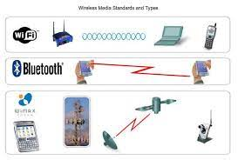
Background
CSE891 | Evaluating Physical-Layer BLE Location Tracking Attacks on Mobile Devices
Nowadays, Location tracking has been one of major feature that every user is looking for in their smart gadgets but what they don’t know about the location tracking is that this feature is very prone to attacks.
By utilizing cryptographic anonymity, these applications restrict the ability of an attacker to utilize these beacons to stalk a person. Attackers can get through these barriers, though, by identifying the distinct physical-layer flaws in a given device's communications.
In particular, earlier research has shown that manufacturing flaws in wireless transmitters (such as carrier frequency offset and I/Q offset) result in a distinct physical-layer fingerprint for that device.

Slide 5
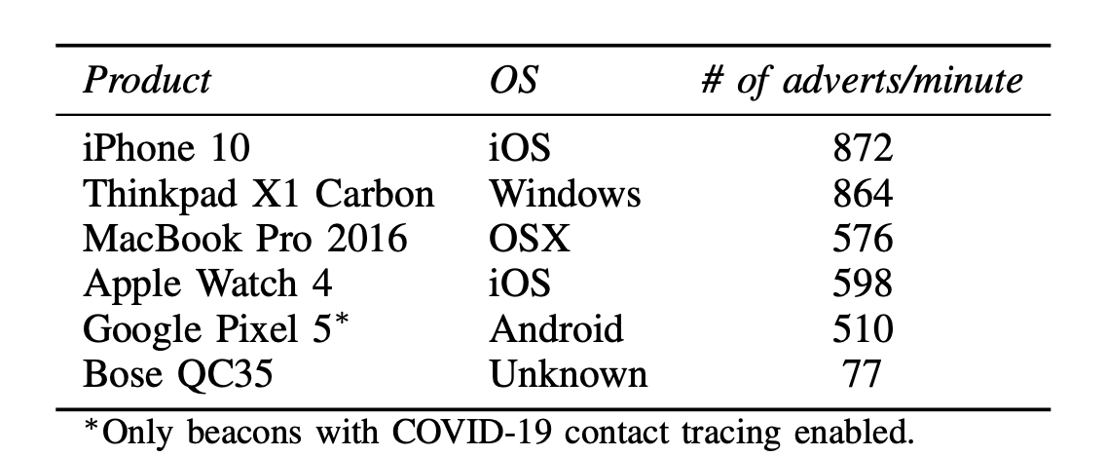

CSE891 | Evaluating Physical-Layer BLE Location Tracking Attacks on Mobile Devices
Due to the failure of existing work and lack of research in this field the researchers decided to evaluate how practical it is for an attacker to track BLE-beaconing devices using their RF fingerprint.
A range of chipsets with various hardware implementations are used in BLE devices.
Some devices have lower SNR BLE transmissions due to applications that can configure the BLE transmit power level.
A significant change in physical-layer impairments can be brought about by the temperature range that mobile devices experience in the field.
The low-cost receivers that an attacker can use in the wild for RF fingerprinting are not noticeably less accurate than the devices utilized in earlier investigations.

Slide 6
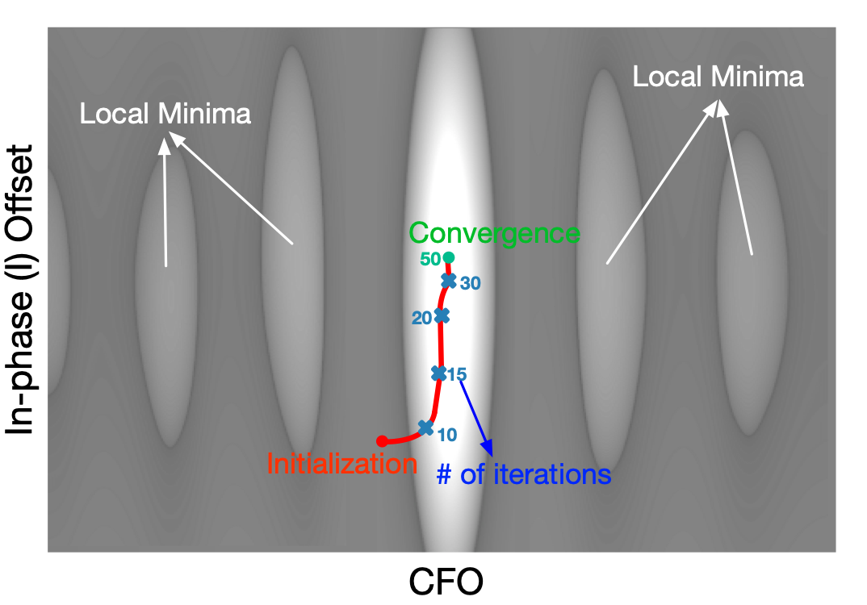

Challenges
CSE891 | Evaluating Physical-Layer BLE Location Tracking Attacks on Mobile Devices
There are few challenges faced by the evaluation process:
They also saw that certain devices share fingerprints with other devices and that a device's metrics can alter depending on the temperature.
Both of these issues can lead to significant misidentification rates.
They found that physical layer tracking of BLE devices is indeed feasible for specific devices with extremely unique fingerprints.
In conclusion, they discovered that physical layer tracking of BLE devices is possible but only trustworthy in certain circumstances.
Notes:
1. For example, consider two people walking and their trajectories intersect now the model analyses the location co-ordinates but only for one person since both are in the same location.

Slide 7
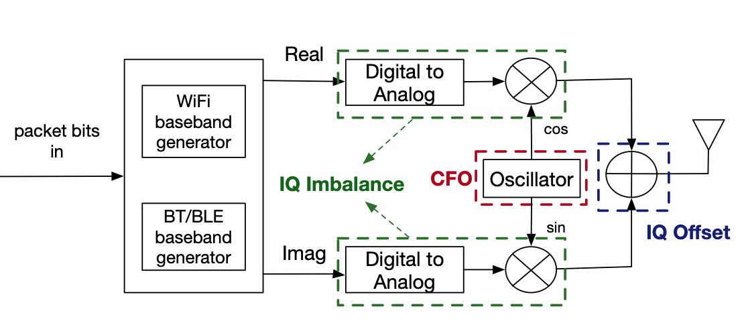

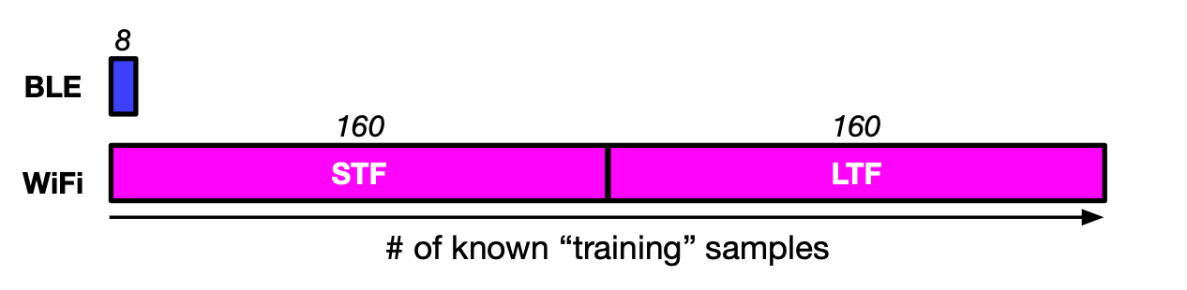

Design Details
CSE891 | Evaluating Physical-Layer BLE Location Tracking Attacks on Mobile Devices
The decision in hardware design has the effect of giving BLE transmissions the same hardware flaws as WiFi. The shared I/Q frontend of the chipset is responsible for the flaws. In BLE and WiFi broadcasts, they lead to two metrics that can be measured: Carrier Frequency Offset (CFO) and I/Q defects, more precisely, I/Q offset and I/Q imbalance. These parameters can be used to uniquely fingerprint WiFi devices, according to earlier research.
Researchers created a method to finely granularly extract hardware flaws like CFO and I/Q offset from BLE data.
Then, in order to assess the advantages and disadvantages of the physical-layer fingerprinting privacy attack in the real world, the researcher were able to gather a sizable dataset of BLE devices that were already in use and analyze their RF fingerprints.

Slide 8
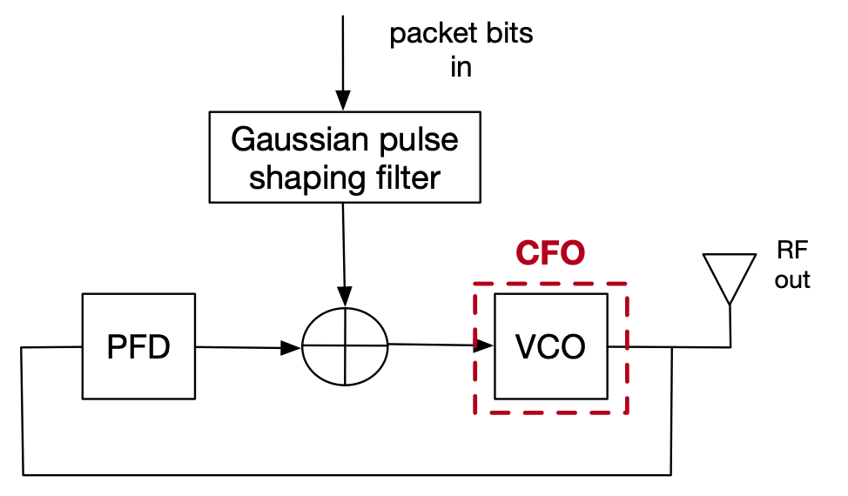

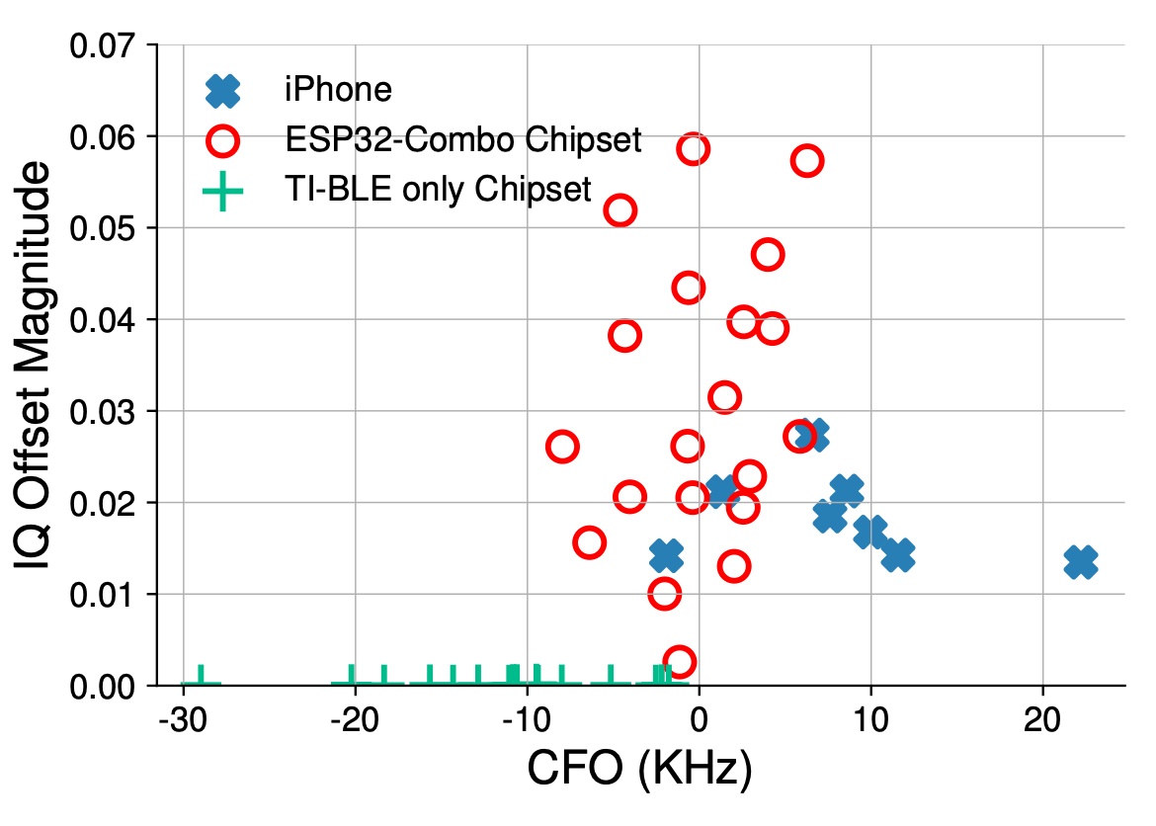

Algorithm Details
CSE891 | Evaluating Physical-Layer BLE Location Tracking Attacks on Mobile Devices
The attack's first stage is to capture BLE packets. They record raw I and Q samples of neighboring BLE signals using an SDR.
This captured BLE packets are processed in two steps: identification and fingerprinting.
During the fingerprinting stage, they briefly isolated the target device and then capture a number of packets to be used in creating the device's fingerprint (i.e., training packets)
The later stage determines whether a captured BLE packet matches the target device's fingerprint.

Slide 9



System Implementation
CSE891 | Evaluating Physical-Layer BLE Location Tracking Attacks on Mobile Devices
Two datasets of BLE beacons were gathered from unattended mobile devices. The initial dataset was gathered in public locations like six coffee shops, a university library, and a food court that were predicted to have a high concentration of stationary BLE-enabled mobile devices.
In all the sites, they counted hundreds of packets coming from 162 different devices. They assessed the false positive and false negative rate of our BLE tracking toolbox using this dataset.
Over the course of 20 hours of data collection, they noticed dozens of packets coming from 647 various devices.
They assessed the distinctiveness of BLE physical-layer fingerprints across a wide range of devices using this dataset.

Slide 10
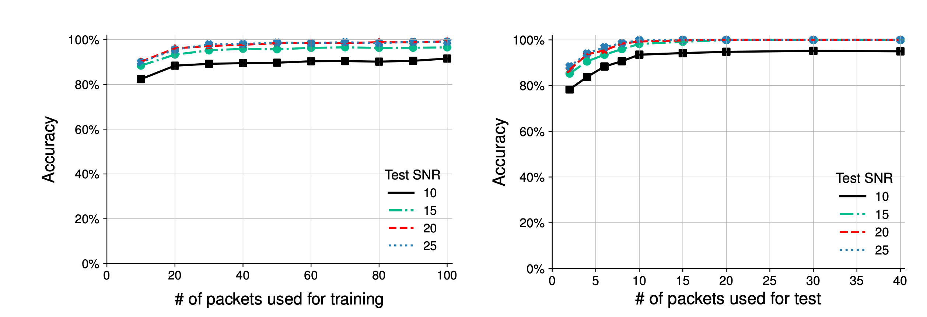
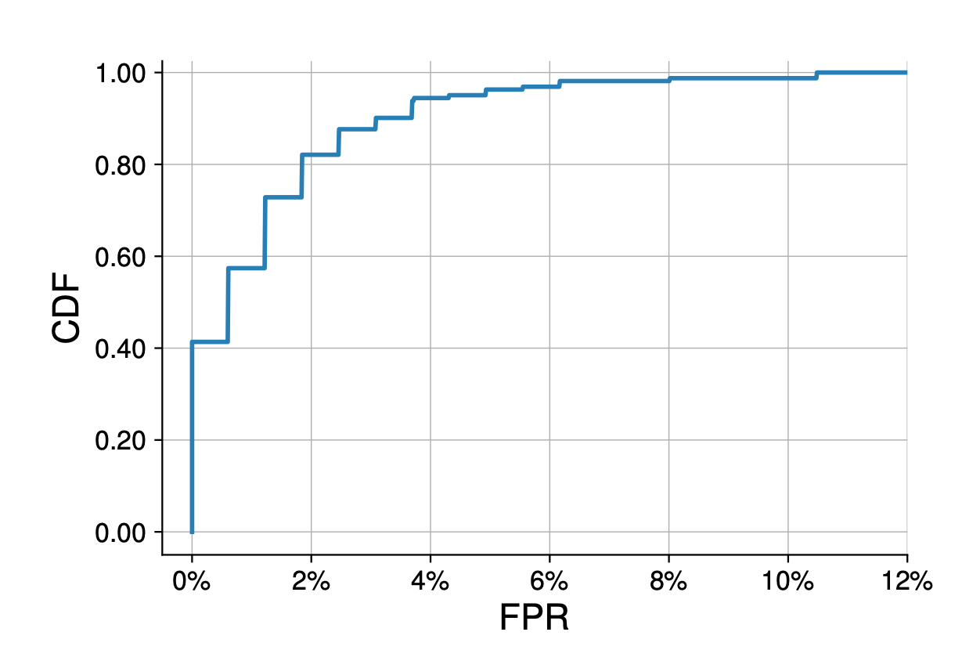
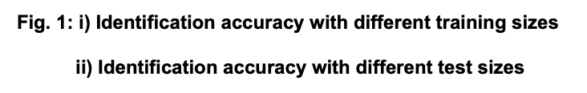
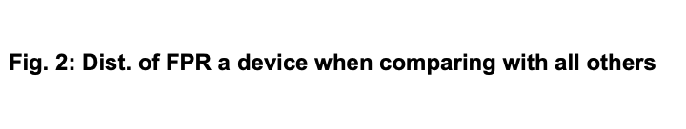
Results
CSE891 | Evaluating Physical-Layer BLE Location Tracking Attacks on Mobile Devices

Slide 11
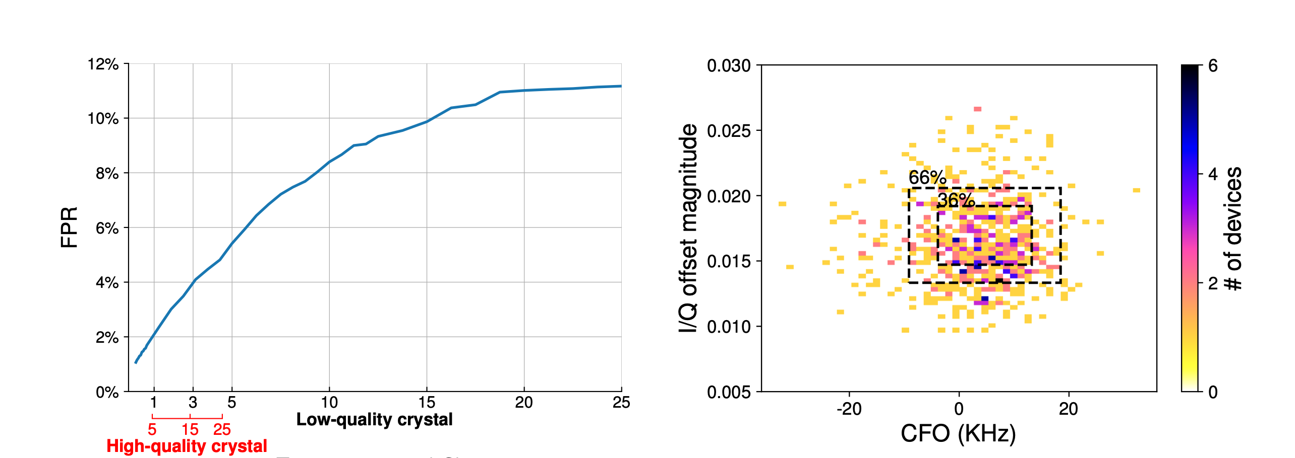
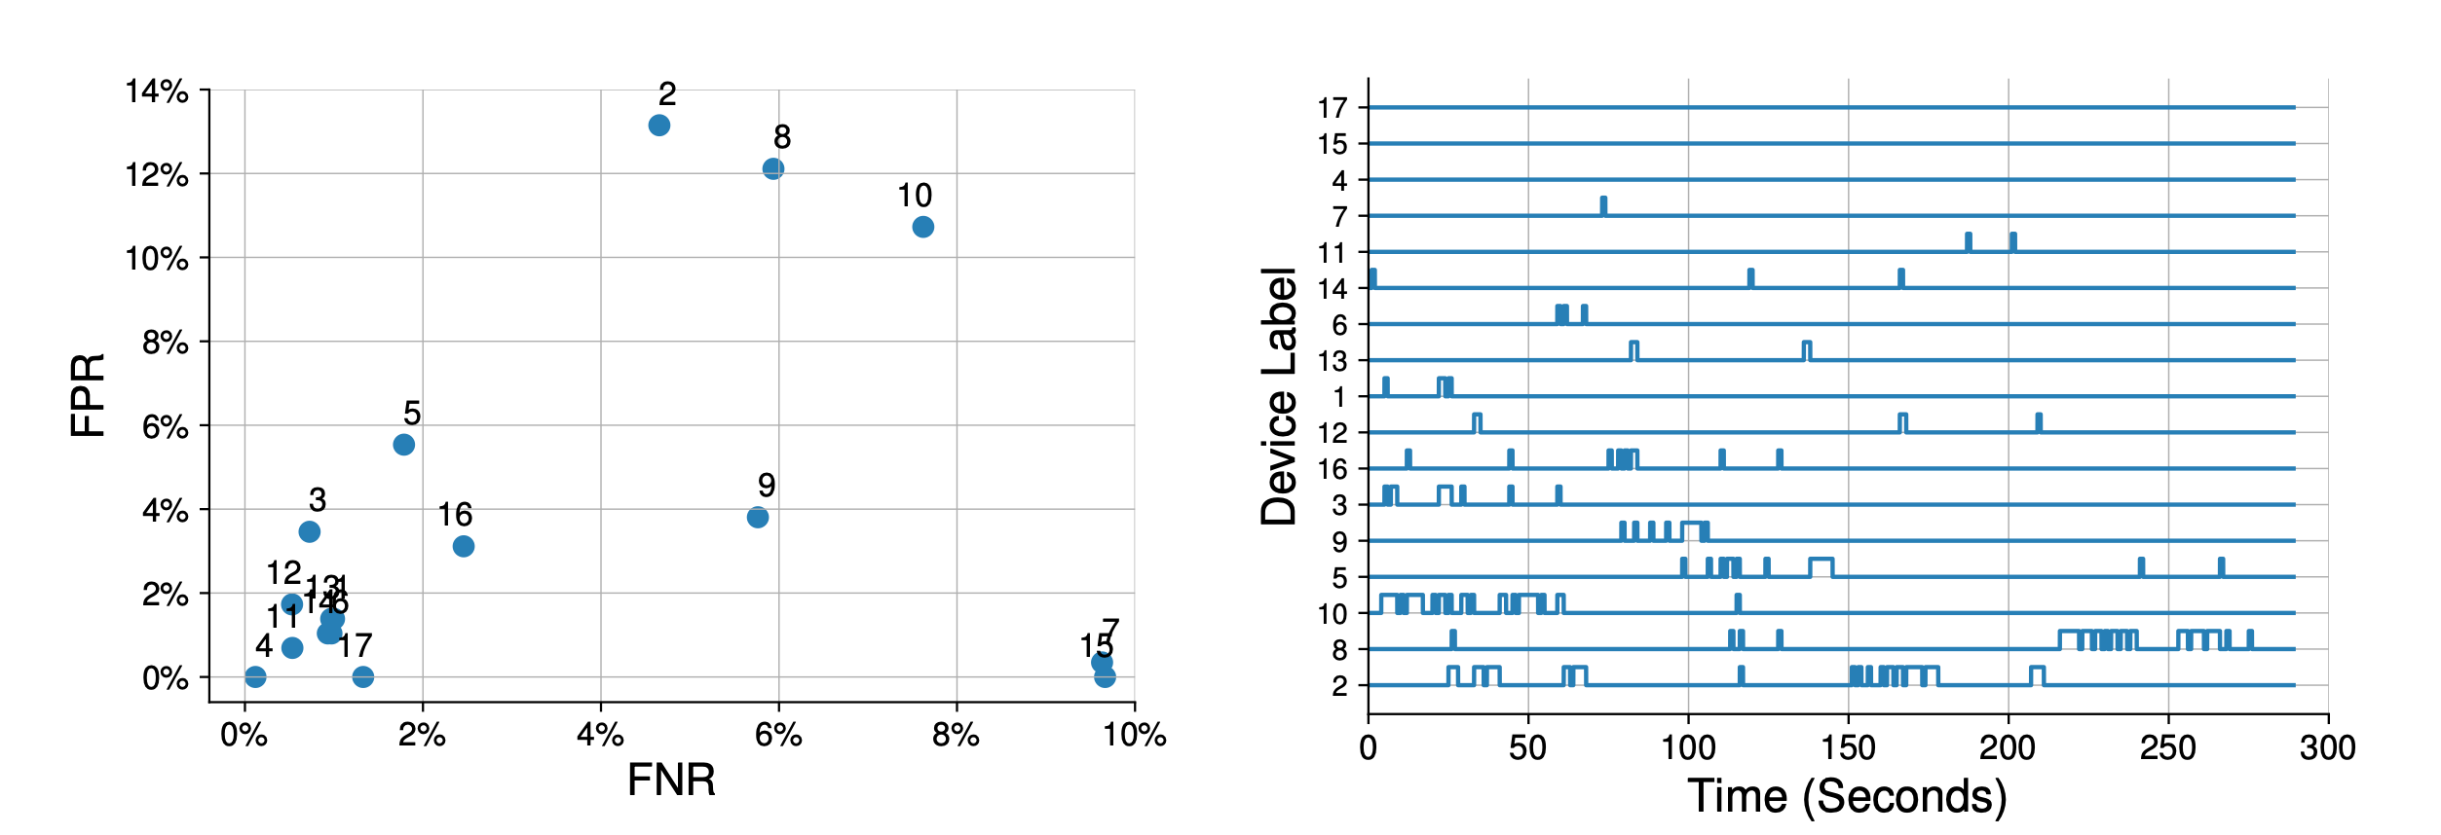
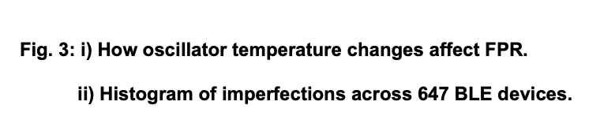
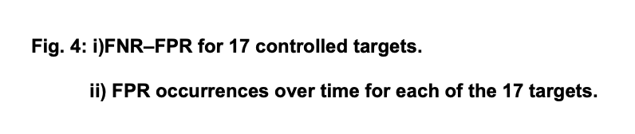
Results
CSE891 | Evaluating Physical-Layer BLE Location Tracking Attacks on Mobile Devices
Notes:
rethink the design of a BLE chipset’s signal chain
We envision adding a random time-varying extra frequency offset the crystal oscillator.

Slide 12
Questions
CSE891 | Evaluating Physical-Layer BLE Location Tracking Attacks on Mobile Devices
?
?
?
?
?
?
?
?
?
?

